Slide 1
MGMT-6064 PROJECT LEADERSHIP AND MANAGEMENT
Module 2: Leadership Definition, Sources of Power

Slide 2
Objectives
Definition of leadership in project management
Leadership vs. management
Talent Triangle
Power and authority
Leader(ship) traits and competencies
Personality and leadership

Slide 3

What is leadership?
“the ability to establish vision and direction, to influence and align others towards a common purpose, and to empower and inspire people to achieve success” (Association for Project Management)
What is project management?
“the application of knowledge, skills, tools, and techniques to project activities to meet the project requirements” (PMI)
Notes:
Image: http://moziru.com/images/illustration-clipart-leadership-2.jpg
Source of Leadership Definition: Association for Project Management (https://www.apm.org.uk/body-of-knowledge/people/interpersonal-skills/leadership/)
Source of PM Definition: https://www.pmi.org/about/learn-about-pmi/what-is-project-management

Slide 4
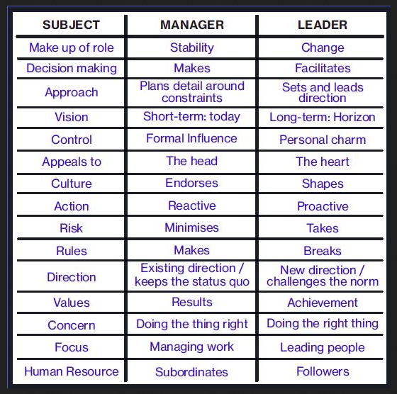
Comparing Management and Leadership
Notes:
Source: https://www.educational-business-articles.com/leadership-versus-management/

Slide 5
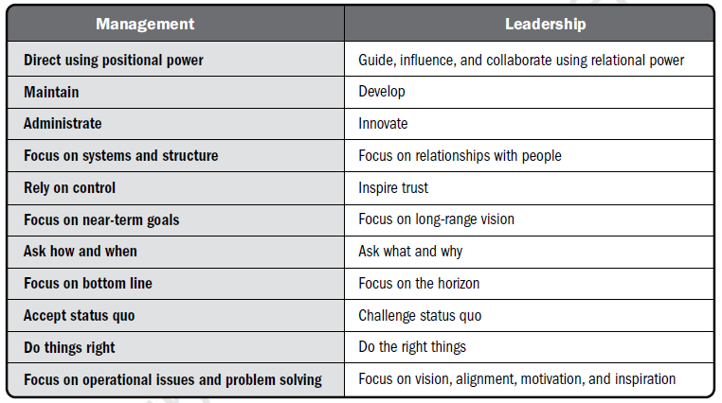
leadership vs management (PMBOK)
Notes:
PMBOK 6e, pg. 64

Slide 6
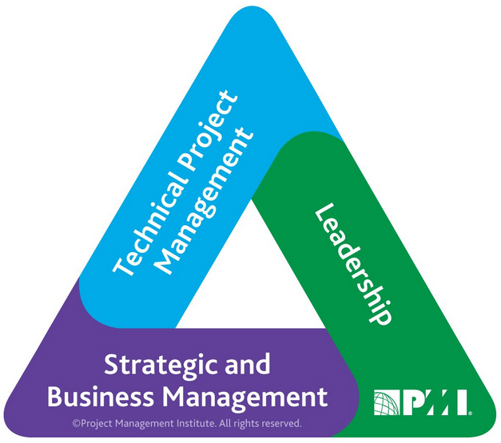
talent Triangle (PMI)
Notes:
Source: https://www.pmi.org/-/media/pmi/documents/public/pdf/certifications/talent-triangle-flyer.pdf

Slide 7
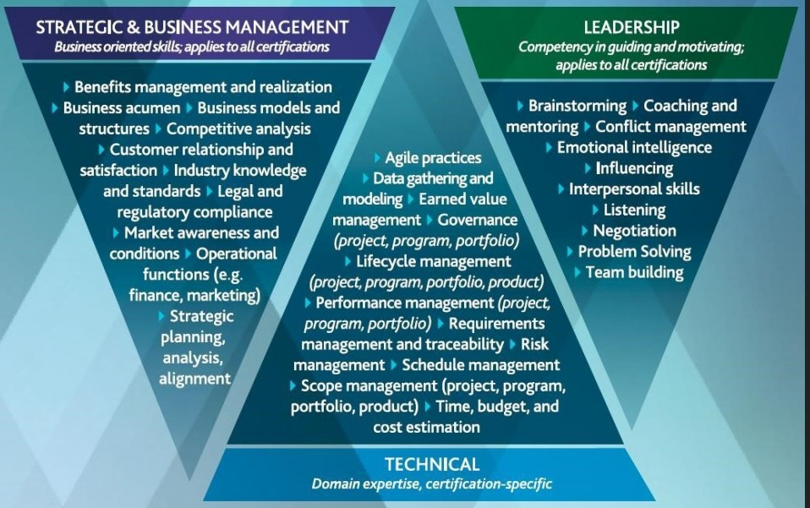
NOTE! You are not required to memorize these details for the mid-term exam, but you may be asked to identify the sides of the talent triangle and general characteristics of each side.)
Notes:
Source: https://www.pmi.org/-/media/pmi/documents/public/pdf/certifications/talent-triangle-flyer.pdf

Slide 8
Leadership Powers
Project Leader Sources of Power
Reward
Coercive
Information
Expertise
Referent
Legitimate
How is a leader able to influence others to ‘get things done’? By exerting power over others…
Legitimate power may be called ‘hard power’, while the other sources of power are called ‘soft power’
Video

Slide 9
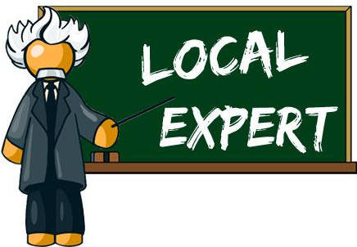
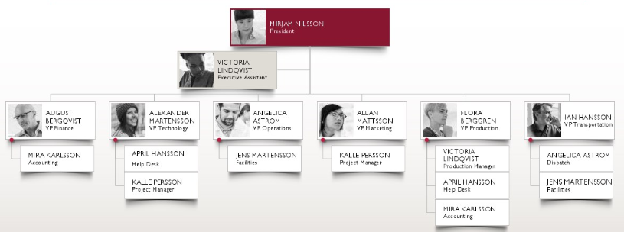
Legitimate & Expert power
Legitimate Power: derived from your formal position of authority or job title
Power rests in the ‘position’, not the ‘person’
Synonymous with authority
Expert Power: ability to generate trust and influence others based on particular skills, knowledge, and expertise
Notes:
https://ugcorigin.s-microsoft.com/100/4967e913-757a-488b-b92b-ab2bfd31be16/200/v4/image.jpg
Image: https://s-media-cache-ak0.pinimg.com/736x/dd/f6/45/ddf645f7e80fb8d205d2b43335979bbf.jpg

Slide 10


Information & Referent power
Information power: ability to influence because you possess knowledge that others want or need
Power comes from your ability to withhold or release a needed resource (i.e., information)
Referent power: ability to attract followers because they respect and admire you
Notes:
Images: http://boldascent.com/wp-content/uploads/2014/08/Charismatic-Leadership1.jpg
Images: http://www.fpgonline.co.uk/wp-content/uploads/2017/10/informationpower-1024x563.png
https://dilbert.com/strip/2015-06-04

Slide 11


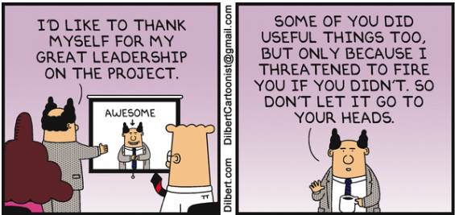
Reward & coercive power
Reward power: ability to give a reward for doing what you want them to do
The ability to deprive someone of a reward for NOT doing what you want them to do
Coercive power: ability to penalize individuals for failure by threatening to use force (physical, economics, emotional, etc.)
Notes:
Image: http://www.boltonstcatherinesacademy.org.uk/files/1514/7637/5745/Rewards_and_Recognition.png
http://static.businessworld.in/article/article_extra_large_image/1499943972_CeJsHW_shutterstock_470-2.jpg
https://dilbert.com/strip/2013-11-08

Slide 12
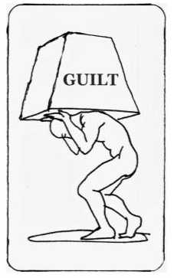




Other sources of power (PMBOK)
Relational: derived from network of professional and/or social connections
Ingratiating: application of flattery to win favour
Guilt-based: imposition of obligation or sense of duty
Persuasive: ability to provide arguments that move people to desired course of action
Avoiding: refusing to participate
Etc…
Notes:
Image: http://edubuzz.org/plhsbbcschoolreport/files/2013/03/Social-Network-Stock-Photo.jpg
http://3.bp.blogspot.com/-vIlibtIt_xg/VAT2NLeKldI/AAAAAAAAMTk/Z6KqKiqlENU/s1600/shutterstock_177633533.jpg
https://rapidlearninginstitute.com/wp-content/uploads/2017/07/flattery.png
http://teacherhabits.com/wp-content/uploads/2017/07/guilt-trip.jpg
http://terrywilson3.com/wordpress/wp-content/uploads/2014/06/persuasion-1-13hbcf32.jpg
PMBOK 6e, pg. 63

Slide 13

common power & authority problems in projects (Kerzner)
Poorly documented or no formal authority
Power & authority are perceived incorrectly
Dual accountability of personnel
Two bosses (who often disagree)
Individualistic org/team/project culture
Shifting of personnel loyalties from vertical to horizontal lines
Group decision making based on the strongest group/person
Inability to influence or administer rewards and punishment
Sharing resources among several projects
Notes:
Image: http://clcrolla.com/clc/wp-content/uploads/2018/05/authority-issues-graphic.jpg

Slide 14
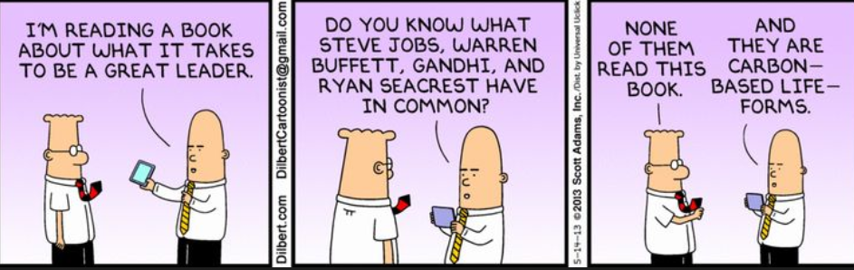
What characteristics do “great leaders” have in common?
Notes:
https://dilbert.com/strip/2013-05-14

Slide 15
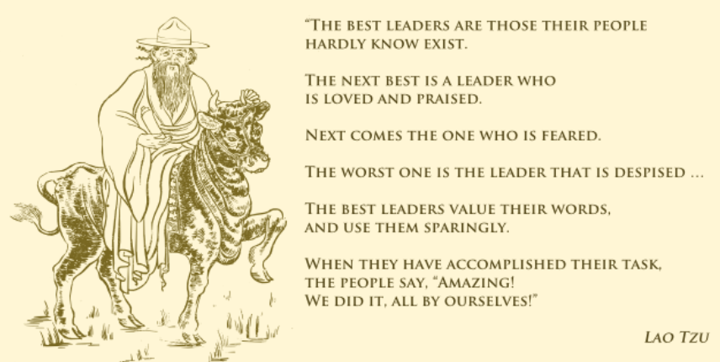
Leadership has been studied for a long time…
Chinese philosopher, born 601 BCE
Notes:
https://scoutmastercg.com/three-leadership-motives/

Slide 16

Competency perspective of leadership
Effective leaders possess specific personal characteristics:
Personality (extraversion, conscientiousness)
Self-concept
Drive
Integrity
Leadership motivation
Knowledge of the business
Cognitive and practical intelligence
Emotional intelligence
Notes:
Source:
McShane, S.L. & Steen, S. (2009). Canadian organizational behaviour (7th ed.). Toronto: McGraw-Hill Ryerson.
Image:
https://csengineermag.com/archived_assets/userfiles/image/AEC-coach-leadership.jpg

Slide 17

PMBOK: qualities & skills of a leader
Visionary
Optimistic
Collaborative
Ability to manage relationships
Communication skills
Respectful
Ethical
Cultural sensitivity
Problem solver
Giving credit to others when due
Lifelong learner
Ability to focus on important things
Holistic perspective
Critical thinking skills
Etc.
Notes:
PMBOK 6e, p. 61-62
Image: https://thehubforstartups.files.wordpress.com/2015/03/dreamstime_m_14281983-follow-the-leader.jpg

Slide 18

Personality and leadership
Personality: the relatively enduring pattern of thoughts, emotions, and behaviours that characterize a person
Two most famous models of personality:
Five-Factor Model
Jungian Personality Theory/Myers-Briggs Type Inventory (MBTI)
Notes:
Sources:
McShane, S.L. & Steen, S. (2009). Canadian organizational behaviour (7th ed.). Toronto: McGraw-Hill Ryerson.
Image:https://www.freshegg.co.uk/m/0/desirable-personality-traits.jpg

Slide 19
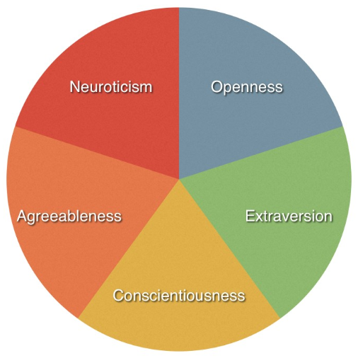
Personality: Five-factor model
Your personality can be reliably measured using five dimensions (“CANOE”):
Conscientiousness: careful, dependable, self-disciplined
Agreeableness: courteous, good-natured, empathetic, caring
Neuroticism: anxious, hostile, depressed
Openness to experience: imaginative, creative, curious, sensitive
Extroversion: outgoing, talkative, sociable, assertive
High conscientiousness and high openness to experience are associated with project success and effective project leadership!
Notes:
Sources:
McShane, S.L. & Steen, S. (2009). Canadian organizational behaviour (7th ed.). Toronto: McGraw-Hill Ryerson.
Image: http://career.iresearchnet.com/wp-content/uploads/2015/03/Big-Five-Factors-of-Personality.jpg
Other sources:
https://www.researchgate.net/publication/4363044_Project_manager_personality_as_a_factor_for_success
https://www.tandfonline.com/doi/abs/10.1080/09537320903498587

Slide 20
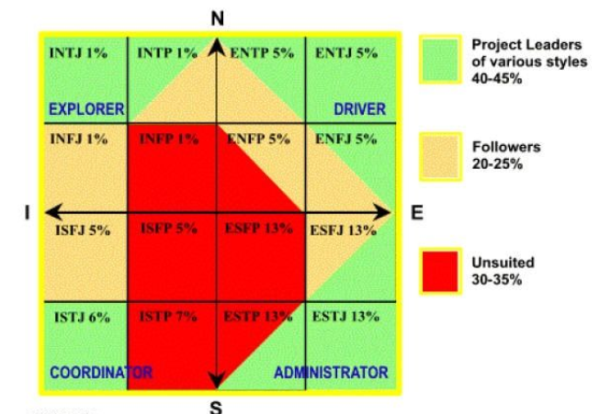
Personality: Jungian personality theory/ mtbi
Your personality can be reliably measured using four dimensions:
Extraversion versus Introversion
Sensing versus iNtuition
Thinking versus Feeling
Judging versus Perception
(Funny video)
Research: There are more NT and fewer SF people in project management compared to the general population…
Notes:
Sources:
Arora, M. & Baronikian, H. (2013). Leadership in project management: Leading people and projects to success (2nd ed.). Toronto: Leadership Publishing House.
https://www.researchgate.net/publication/263596981_MBTI_Personality_Types_of_Project_Managers_and_Their_Success_A_Field_Survey
Suggested reading: https://careerassessmentsite.com/category/project-management/

Slide 21
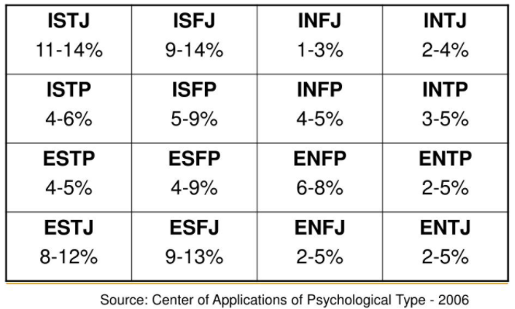
Personality: Jungian personality theory/ mtbi
Extraversion versus Introversion
Sensing versus iNtuition
Thinking versus Feeling
Judging versus Perception
Notes:
Sources:
Arora, M. & Baronikian, H. (2013). Leadership in project management: Leading people and projects to success (2nd ed.). Toronto: Leadership Publishing House.
https://www.researchgate.net/publication/263596981_MBTI_Personality_Types_of_Project_Managers_and_Their_Success_A_Field_Survey
Suggested reading: https://careerassessmentsite.com/category/project-management/

Slide 22
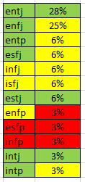
Personality: Jungian personality theory/ mtbi
Extraversion vs Introversion - Sensing vs iNtuition - Thinking vs Feeling - Judging vs Perception
Results from MGMT 6064 students who took this course in the past
Notes:
Sources:
Arora, M. & Baronikian, H. (2013). Leadership in project management: Leading people and projects to success (2nd ed.). Toronto: Leadership Publishing House.
https://www.researchgate.net/publication/263596981_MBTI_Personality_Types_of_Project_Managers_and_Their_Success_A_Field_Survey
Suggested reading: https://careerassessmentsite.com/category/project-management/

Slide 23
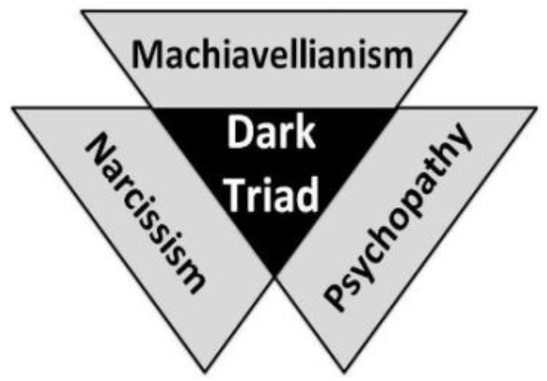
Personality: the dark triad
The combination of three socially malevolent characteristics and behaviours:
Machiavellianism: manipulative, cunning, low concern for others
Narcissism: entitled, selfish, arrogant, need for admiration, desire for power
Psychopathy: low empathy for others, lack of remorse, skilled impression manager
Dark triad personalities are often found in leadership and management, particularly in business and politics…
Notes:
Nahavandi, A., (2015). The art and science of leadership (7th ed.). New Jersey: Pearson.
Image: http://www.returnofkings.com/wp-content/uploads/2015/07/dtr.jpg
Suggested Reading: https://en.wikipedia.org/wiki/Dark_triad

